Slide 1

Sampling Techniques
& Samples Types
Dr.Gavisiddappa Gadag
Associate Professor
Department of Commerce
Smt.A.S.M.College for Women, Ballari.

Slide 2

Outlines
Sample definition
Purpose of sampling
Stages in the selection of a sample
Types of sampling in quantitative researches
Types of sampling in qualitative researches
Ethical Considerations in Data Collection

Slide 3

Sampling…
The process of selecting a number of individuals for a study in such a way that the individuals represent the larger group from which they were selected

Slide 4
SAMPLING…….
STUDY POPULATION
SAMPLE
TARGET POPULATION

Slide 5
A sample is “a smaller (but hopefully representative) collection of units from a population used to determine truths about that population” (Field, 2005)
The sampling frame
A list of all elements or other units containing the elements in a population.

Slide 6

Population…
…the larger group from which individuals are selected to participate in a study

Slide 7
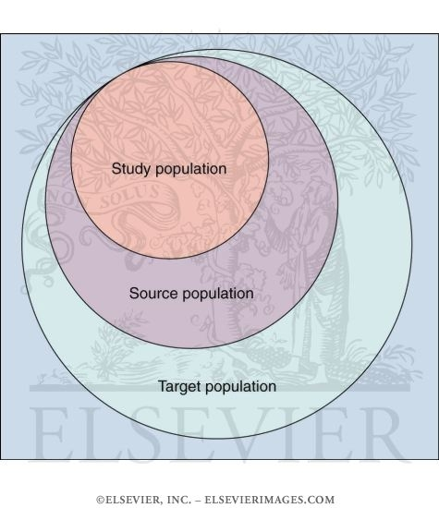
Target population
A set of elements larger than or different from the population sampled and to which the researcher would
like to generalize
study findings.

Slide 8
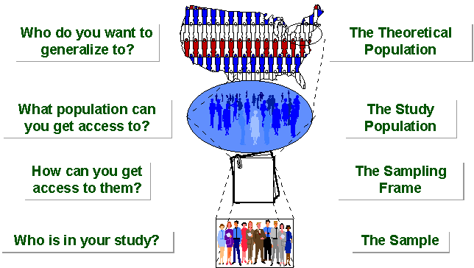
Notes:
Picture of sampling breakdown

Slide 9

The purpose of sampling…
To gather data about the population in order to make an inference that can be generalized to the population

Slide 10

Stages in the
Selection
of a Sample
Define the target population
Select a sampling frame
Determine if a probability or nonprobability
sampling method will be chosen
Plan procedure for selecting
sampling units
Determine sample size
Select actual sampling units
Conduct fieldwork

Slide 11
Quantitative Sampling
Purpose – to identify participants from whom to seek some information
Issues
  Nature of the sample (random samples)
  Size of the sample
  Method of selecting the sample

Slide 12
Quantitative Sampling
Important issues
  Representation – the extent to which the sample is representative of the population
  Generalization – the extent to which the results of the study can be reasonably extended from the sample to the population
  Sampling error
    The chance occurrence that a randomly selected sample is not representative of the population due to errors inherent in the sampling technique

Slide 13
Quantitative Sampling
Important issues (continued)
  Sampling bias
    Some aspect of the researcher’s sampling design creates bias in the data.
  Three fundamental steps
    Identify a population
    Define the sample size
    Select the sample

Slide 14
Types of sampling in quantitative researches
Probability samples
Non-probability samples

Slide 15
Selecting Random Samples
Known as probability sampling
Best method to achieve a representative sample
Four techniques
  Random
  Stratified random
  Cluster
  Systematic

Slide 16
Selecting Random Samples
Random sampling
Selecting subjects so that all members of a population have an equal and independent chance of being selected
  Advantages
    Easy to conduct
    High probability of achieving a representative sample
    Meets assumptions of many statistical procedures
  Disadvantages
    Identification of all members of the population can be difficult
    Contacting all members of the sample can be difficult

Slide 17
Selecting Random Samples
Random sampling (continued)
  Selection process
    Identify and define the population
    Determine the desired sample size
    List all members of the population
    Assign all members on the list a consecutive number
    Select an arbitrary starting point from a table of random numbers and read the appropriate number of digits

Slide 18

Selecting Random Samples
Stratified random sampling
  The population is divided into two or more groups called strata, according to some criterion, such as geographic location, grade level, age, or income, and subsamples are randomly selected from each strata.

Slide 19
Selecting Random Samples
Stratified random sampling (continued)
  Advantages
    More accurate sample
    Can be used for both proportional and non-proportional samples
    Representation of subgroups in the sample
  Disadvantages
    Identification of all members of the population can be difficult
    Identifying members of all subgroups can be difficult

Slide 20
Selecting Random Samples
Stratified random sampling (continued)
  Selection process
    Identify and define the population
    Determine the desired sample size
    Identify the variable and subgroups (i.e., strata) for which you want to guarantee appropriate representation
    Classify all members of the population as members of one of the identified subgroups

Slide 21
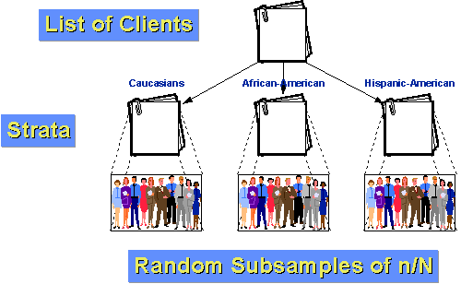
Stratified random sampling

Slide 22
Selecting Random Samples
Cluster sampling
The process of randomly selecting intact groups, not individuals, within the defined population sharing similar characteristics
Clusters are locations within which an intact group of members of the population can be found
    Examples
      Neighborhoods
      School districts
      Schools
      Classrooms

Slide 23
Selecting Random Samples
Cluster sampling (continued)
  Advantages
    Very useful when populations are large and spread over a large geographic region
    Convenient and expedient
    Do not need the names of everyone in the population
  Disadvantages
    Representation is likely to become an issue

Slide 24
Selecting Random Samples
Cluster sampling (continued)
  Selection process
    Identify and define the population
    Determine the desired sample size
    Identify and define a logical cluster
    List all clusters that make up the population of clusters
    Estimate the average number of population members per cluster
    Determine the number of clusters needed by dividing the sample size by the estimated size of a cluster
    Randomly select the needed numbers of clusters
    Include in the study all individuals in each selected cluster

Slide 25
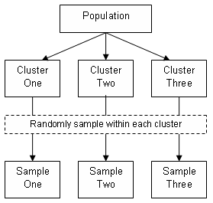
Cluster sampling

Slide 26
Selecting Random Samples
Systematic sampling
  Selecting every K^{th} subject from a list of the members of the population
  Advantage
    Very easily done
  Disadvantages
    subgroups
    Some members of the population don’t have an equal chance of being included

Slide 27
Selecting Random Samples
Systematic sampling (continued)
  Selection process
    Identify and define the population
    Determine the desired sample size
    Obtain a list of the population
    Determine what K is equal to by dividing the size of the population by the desired sample size
    Start at some random place in the population list
    Take every K^{th} individual on the list

Slide 28
Systematic sampling
Example, to select a sample of 25 dorm rooms in your college dorm, makes a list of all the room numbers in the dorm. For example there are 100 rooms, divide the total number of rooms (100) by the number of rooms you want in the sample (25). The answer is 4. This means that you are going to select every fourth dorm room from the list. First of all, we have to determine the random starting point. This step can be done by picking any point on the table of random numbers, and read across or down until you come to a number between 1 and 4. This is your random starting point. For instance, your random starting point is "3". This means you select dorm room 3 as your first room, and then every fourth room down the list (3, 7, 11, 15, 19, etc.) until you have 25 rooms selected.

Slide 29
SAMPLE SIZE
According to Uma Sekaran in Research Method for Business 4th Edition, Roscoe (1975) proposed the rules of thumb for determining sample size where sample size larger than 30 and less than 500 are appropriate for most research, and the minimum size of sample should be 30% of the population.
The size of the sample depends on a number of factors and the researchers have to give the statistically information before they can get an answer. For example, these information like (confidence level, standard deviation, margin of error and population size) to determine the sample size.

Slide 30

Types of sampling in quantitative researches
Non-probability samples
(Random): allows a procedure governed by chance to select the sample; controls for sampling bias.

Slide 31

Nonrandom sampling methods...
1. Convenience sampling
2. Purposive sampling
3. Quota sampling

Slide 32
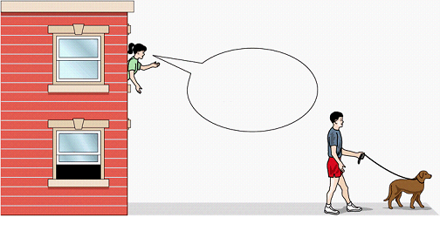
Convenience sampling:
the process of including whoever happens to be available at the time
…called “accidental” or “haphazard” sampling

Slide 33
disadvantages…
…difficulty in determining how much of the effect (dependent variable) results from the cause (independent variable)

Slide 34

2. Purposive sampling:
the process whereby the researcher selects a sample based on experience or knowledge of the group to be sampled
…called “judgment” sampling

Slide 35
disadvantages…
…potential for inaccuracy in the researcher’s criteria and resulting sample selections

Slide 36

3. Quota sampling
the process whereby a researcher gathers data from individuals possessing identified characteristics and quotas

Slide 37
disadvantages…
…people who are less accessible (more difficult to contact, more reluctant to participate) are under-represented

Slide 38

Sampling
in
Qualitative Research

Slide 39
Sampling in Qualitative Research
Researchers in qualitative research select their participants
according to their :
characteristics
knowledge

Slide 40
The purposeful sampling
It is when the researcher chooses persons or sites which provide specific knowledge about the topic of the study.

Slide 41

Types of Purposeful Sampling
Maximal Variation Sampling
Typical Sampling
Theory or Concept Sampling
Homogeneous Sampling
Critical Sampling
Opportunistic Sampling
Snowball Sampling

Slide 42
1- Maximal Variation Sampling
It is when you select individuals that differ on a certain characteristic. In this strategy you should first identify the characteristic and then find individuals or sites which display that characteristic.

Slide 43
2- Typical Sampling
It is when you study a person or a site that is “typical” to those unfamiliar with the situation. You can select a typical sample by collecting demographic data or survey data about all cases.

Slide 44
3-Theory or Concept Sampling
It is when you select individuals or sites because they can help you to generate a theory or specific concepts within the theory. In this strategy you need a full understanding of the concept or the theory expected to discover during the study.

Slide 45
4- Homogeneous Sampling
It is when you select certain sites or people because they possess similar characteristics. In this strategy, you need to identify the characteristics and find individuals or sites that possess it.

Slide 46
5- Critical Sampling
It is when you study an exceptional case represents the central phenomenon in dramatic terms.

Slide 47
6- Opportunistic Sampling
It is used after data collection begins, when you may find that you need to collect new information to answer your research questions.

Slide 48

7- Snowball Sampling
It is when you don't know the best people to study because of the unfamiliarity of the topic or the complexity of events. So you ask participants during interviews to suggest other individuals to be sampled.

Slide 49


Ethical Considerations in Data Collection
It is the researcher’s ethical responsibility to safeguard the story teller by maintaining the understood purpose of the research…
The relationship should be based on trust between the researcher and participants.
Inform participants of the purpose of the study.

Slide 50
Being respectful of the research site, reciprocity, using ethical interview practices, maintaining privacy, and cooperating with participants.
Patton (2002) offered a checklist of general ethical issues to consider, such as:
reciprocity
assessment of risk
confidentiality,
informed consent
and data access and ownership.

Slide 51

Qualitative researchers must be aware of the potential for their own emotional turmoil in processing this information
During the interview process, participants may disclose sensitive and potentially distressing information in the course of the interview..

Slide 52



