Slide 1




STAFFING

Slide 2
Meaning
Staffing is the process of filling positions/posts in the organization with adequate and qualified personnel .
Staffing is the process of acquiring, deploying, and retaining a workforce of sufficient quantity and quality to create positive impacts on the organization's effectiveness

Slide 3
Definitions
According to McFarland,
“Staffing is the function by which managers build an organization through the recruitment, selection, and development of individuals as capable employees.”
According to Koontz, O’Donnell and Heinz Weihrich,
“The management function of staffing is defined as filling position in the organization structure through identifying workforce requirements, inventorying the people available, recruitment, selection, placement, promotion, appraisal, compensation, and training of needed people.”

Slide 4
Features of staffing function
All pervasive function of management.
Dynamic function.
Vast scope.

Slide 5
Main Objective Of Staffing
To understand all function of in an organization.
To understand manpower planning so that people are available at right time and at a right place.
To understand issues related to job analysis and to overcome the problem.

Slide 6



Importance Of
Staffing Function

Slide 7
Importance Of Staffing
Training and Development.
Effective Co-ordination.
Effective Recruitment & Placement.
Building effective human resource.

Slide 8
Importance of Staffing Function
Optimum Use of Resource.
Enhances Corporate Image.
Job Satisfaction.

Slide 9
ELEMENTS OF STAFFING
Manpower planning
Job analysis
Recruitment and selection
Training and Development
Performance appraisal

Slide 10
Scope of Staffing
Hiring
Motivation
Employee maintenance
Human relations

Slide 11


Factors Affecting Staffing

Slide 12

External Factors Affecting Staffing
Nature of rivalry for Human Resources
India has ample supply of unskilled workers then highly qualified people.
Companies start to change their staffing policy and prefer less talented people.

Slide 13
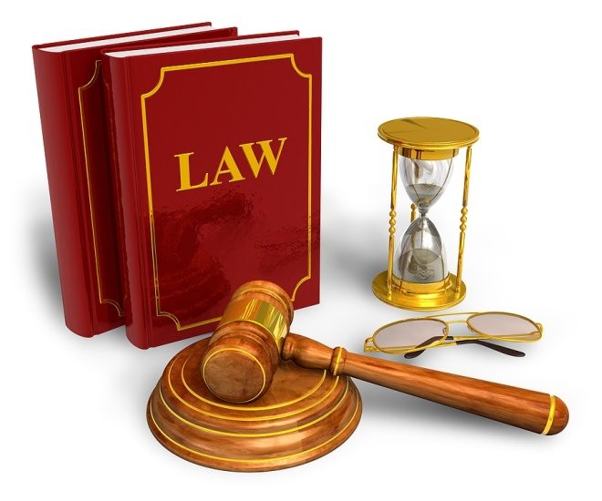
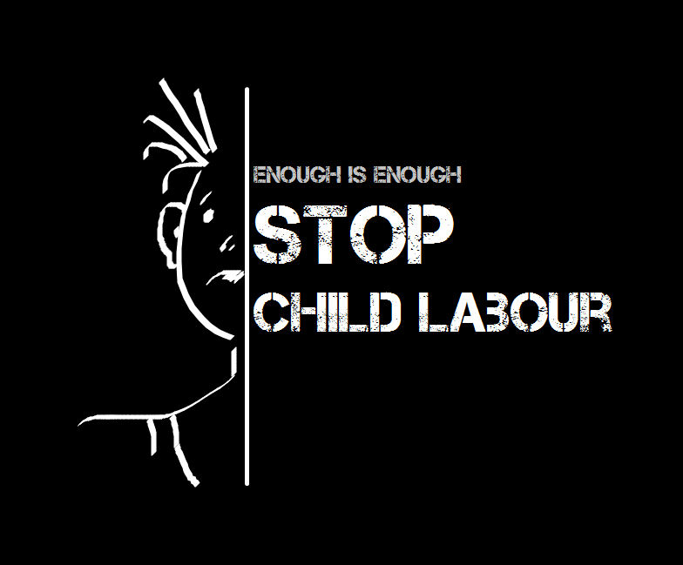
Legal factors
Child labour is prohibited.
Provision are there relating to reservations for physically handicapped people.
Legal provision affects the staffing policy of an organization.

Slide 14


Socio-cultural factors
Employment of women for job involving physical
exertion is usually avoided
Women are not offered jobs involving continuous travelling.

Slide 15
External Influences
Employers have to face pressures from political parties or politicians as new recruitment.
Concept of Employment to “Sons of the soil” is getting popular in all countries.
External Influences affect the staffing policy of business unit.

Slide 16
Internal Factors Affecting Staffing
Organizational Image
Past Practices
Size of the Organization
Organizational Business Plan

Slide 17


Slide 18

Recruitment
Process of locating, identifying, and attracting capable candidates
Can be for current or future needs
Critical activity for some corporations.
What sources do we use for recruitment

Slide 19
Recruitment
Meaning:-
Recruitment means to estimate the available vacancies in the organization and to make arrangements for their selection and appointment.
Recruitment is a positive function in which publicity is given to the jobs available in the organization and interested candidates are encouraged to submit applications for the selection.
In the recruitment, a pool of eligible and interested candidates is created for the selection of most suitable candidates.

Slide 20
Definitions
According to Edwin Flippo,
“Recruitment is the process of searching for prospective employees and stimulating them to apply for jobs in the organization.”

Slide 21

Need of Recruitment
Vacancies due to promotions, transfers, retirement, termination, permanent disability, death and labour turnover.
Creation of new vacancies due to growth, expansion and diversification of business activities of an enterprise. New vacancies are also possible due to job specification.

Slide 22
School
Placement
Employee
Referrals
Internal
Searches
Recruitment
Sources
Voluntary
Applicants
Employment
Agencies
Advertisements

Slide 23
Internal Sources of Recruitment
Promotions
Transfers
Internal Notifications(Advertisement)
Former Employees

Slide 24

External Sources of Recruitment
Campus Recruitment (Interview).
Press Advertisement.
Recruitment through Management Consultants and Private Employment Exchanges.

Slide 25

External Sources of Recruitment
Deputation of Personnel.
Management Training Schemes.
Walk-ins, Write-ins and talk-ins.

Slide 26
SELECTION
A series of steps from initial applicant screening to final hiring of the new employee.
  Selection process.
    Step 1: Completing application materials.
    Step 2: Conducting an interview.

Slide 27
    Step 3: Completing any necessary tests.
    Step 4: Doing a background investigation.
    Step 5: Socialization
    Step 6: Deciding to hire or not to hire.

Slide 28
Recruitment & selection
Recruitment is the process of finding and attracting capable applicants for employment. The process begins when new recruits are sought and ends when their applications are submitted. The result is a pool of applicants from which new employees are selected.
Selection is the process of differentiating between applicants in order to identify and hire those with a greater likelihood of success in a job.

Slide 29
Difference : Recruitment & selection
RECRUITMENT SELECTION
To attract maximum number To choose best out of the
of candidates. available candidates.
It creates application pool It is a rejection process
as large as possible. where few are selected.
Techniques are not very Highly specialized techniques
intensive. are required.
Outcome is application Outcome is the candidate who
pool. is offered job.

Slide 30
Process
RECRUITMENT SELECTION
Advertisement Screening of applications
Employment agencies Selection tests
On campus recruitment Interview
Deputation Checking of references
Employee recommendations Physical examination
Labor unions Approval by authority
Gate hiring Placement

Slide 31
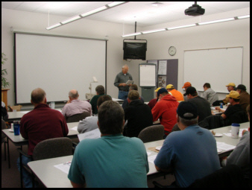
Training & development
“Training is a short term process utilizing a systematic and organized procedure by which non managerial personnel learn technical knowledge and skills for a definite purpose”.
“Development is a long term educational process utilizing a systematic and organized procedure by which managerial personnel learn conceptual and theoretical knowledge for general purpose”.

Slide 32

Importance of training & development
Increase In Efficiency
Increase In Morale Of Employees
Better Human Relations
Reduced Supervision
Increased Organizational Viability & Flexibility

Slide 33

Conclusion
Staffing is the most vital asset with an organization, without which it cannot move ahead in the competitive world. It can be equated with HR management as both have same sort of objectives. Staffing is an open system approach. It is carried out within the enterprise but is also linked to external environment.

