Slide 1
MID-POINT CIRCLE ALGORITHM

Slide 2
Defination
The midpoint circle algorithm is an algorithm used to determine the points needed for drawing a circle.
At each step, the path is extended by choosing the adjacent pixel which satisfies but maximizes .
We only need to calculate the values on the border of the circle in the first octant. The other values may be determined by symmetry. Assume a circle of radius r with center at (h,k)

Slide 3
The first thing we can notice to make our circle drawing algorithm more efficient is that circles centred at (h,k) have eight-way symmetry
Procedure Circle Points(x,y,Integer);
Begin
Plot(x,y);
Plot(y,x);
Plot(y,-x);
Plot(x,-y);
Plot(-x,-y);
Plot(-y,-x);
Plot(-y,x);
Plot(-x,y)
End;
(-x, y)
(x, y)
(-y, x)
(y, x)
(-y, -x)
(y, -x)
(-x, -y)
(x, -y)

Slide 4
For a point in the interior of the circle, the circle function is negative and for a point outside the circle, the function is positive
Thus,
  f_{circle}(x,y) < 0 if (x,y) is inside the circle boundary
  f_{circle}(x,y) = 0 if (x,y) is on the circle boundary
  f_{circle}(x,y) > 0 if (x,y) is outside the circle boundary.
yk
X²+y²-r²=0
Yk-1
Midpoint between candidate pixels at sampling position x_{k}+1 along a circular path
Midpoint
xk
xk+1
Xk+3

Slide 5
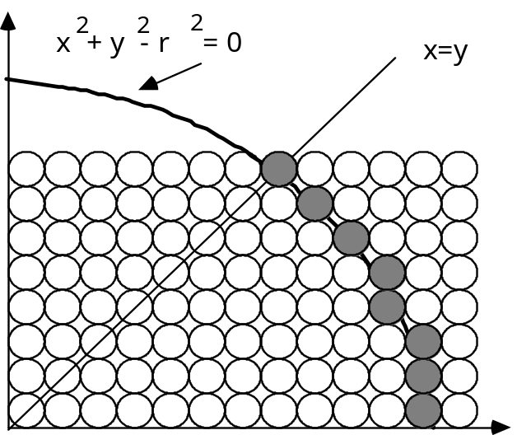
1: Input radius r and circle center (x_{c},y_{c}) and obtain the first point on the circumference of the circle centered on the origin as (x₀,y₀) = (0,r)
2: Calculate the initial value of the decision parameter as
P₀ = 5/4 - r
3: At each x_{k} position starting at k = 0 , perform the following test:
If p_{k} < 0 , the next point along the circle centered on (0,0) is (x_{k+1}, y_{k}) and
p_{k+1} = p_{k} + 2x_{k+1} + 1

Slide 6
Otherwise the next point along the circle is (x_{k+1}, y_{k-1}) and
p_{k+1} = p_{k} + 2x_{k+1} +1 -2y_{k+1}
Where 2x_{k+1} = 2x_{k+2} and 2y_{k+1} = 2y_{k}-2
4: Determine symmetry points in the other seven octants
5: Move each calculated pixel position (x,y) onto the circular path centered on (x,yc) and plot the coordinate values
x = x+ x_{c} , y= y+ y_{c}
6: Repeat steps 3 through 5 until x >= y

Slide 7
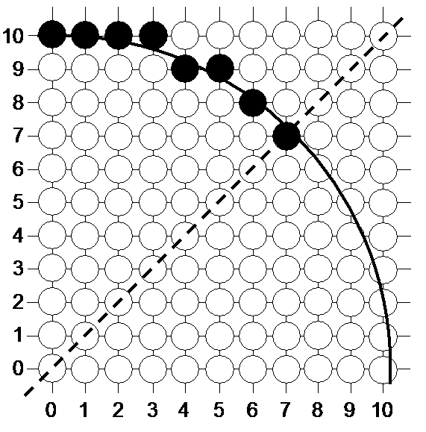
Mid-Point Circle Algorithm
k | P_{k} | x_{k+1} , y_{k–} ₁ | 2x_{k+1} | 2y_{k+1}
0 | -9 | (1, 10) | 2 | 20
1 | -6 | (2, 10) | 4 | 20
2 | -1 | (3, 10) | 6 | 20
3 | 6 | (4, 9) | 8 | 18
4 | -3 | (5, 9) | 10 | 18
5 | 8 | (6, 8) | 12 | 16
6 | 5 | (7, 7) | 14 | 14
A plot of the generated pixel positions in the first quadrant is shown in the figure

Slide 8
The key insights in the mid-point circle algorithm are:
  Eight-way symmetry can hugely reduce the work in drawing a circle
  Moving in unit steps along the x axis at each point along the circle’s edge we need to choose between two possible y coordinates

Slide 9
The circles can be drawn with different radius
y
x
y
x

Slide 11
Use 8-fold symmetry and only compute pixel positions for the 45° sector.
(-x, y)
(x, y)
(-y, x)
45°
(y, x)
(-y, -x)
(y, -x)
(-x, -y)
(x, -y)

