Slide 1
MARKETING COMMUNICATION STRATEGY

Slide 2

Marketing definition
According to American Marketing Association
“marketing is the activity, set of institutions, and processes for creating , communicating, delivering, and exchanging offering that have value for customers, clients, partners, and society at large.”

Slide 3

Marketing communication
Meaning :
Marketing communication is to coordinated promotional messages delivered one or more channels such as print, radio, television, direct- mail, and personal selling

Slide 4
What is marketing communication strategy
It helps to develop brand awareness, which means that consumers translate product information into perceptions about the product’s attributes and its position within the larger market
Marketing communication is to retain the product’s current customer base, and to cement relationships with customers and suppliers
It defines the business plan for product information dissemination and brand awareness development

Slide 5
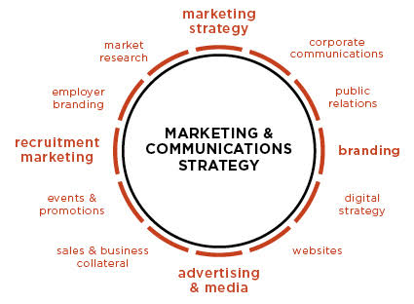

Slide 6
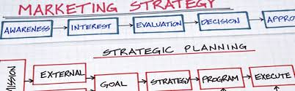
Marketing strategy process or planning
Strategy is a plan designed to achieve a long-term aim.
Scanning the marketing environment
Internal scanning
Setting the marketing objectives
Formulating the marketing strategy
developing the functional plans

Slide 7
Marketing communication and its process
It essentially a part of the marketing mix the marketing mix defines the 4ps of marketing and promotion is what marketing communication is all about
Traditionally printed marketing was the whole sole method of conveying the messages to the consumers. However, in recent times, emails, blogs, television and company websites have become the trendy way of conveying the organization’s message to the consumers

Slide 8
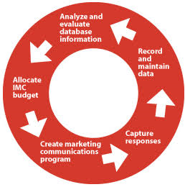
Marketing Communication process

Slide 9
messaging
Public relations
advertising
E-mail
Web site
seminars
Developing Marketing communication strategy
Conferences & trade shows
Downloadable materials
Direct marketing
packaging
Event sponsorship
Merchandising promotion

Slide 10

Objectives of marketing communication strategy
Aiming
Encoding
Transmitting
Receiving
Decoding
Responding

Slide 11
Encoding: putting thoughts, ideas, or information into a symbolic form is termed as encoding
Aiming: having the intention of achieving
Transmitting: to communicate, as information or news, to pass or spread to another
Receiver: it is the target audience or customers who receive the message by way of reading, hearing, or seeing
Decoding: it is highly influenced by the self-reference criteria which is unintended reference to one’s own culture
Responding: to reply or answer in words, to react favorably

Slide 12
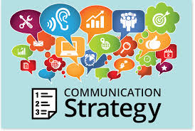
Integration and implement marketing communication strategy
Integrate promotional-mix strategy
Create and produce ads
Purchase media time, space, etc…
Design and implement direct-marketing programs
Design and distribute sales promotion materials
Design and implement publicity programs
Design and implement interactive/internet marketing program

Slide 13
Marketing communication strategy
Advantages
Disadvantages
It is bigger markets
Better and varied goods
Better investment can be done easily
Good opportunities
Unemployment problem
Financial insecurity
Unequal opportunities
Economic interdependence

Slide 14
Thank you

